Slide 1
Local Plan Update and Waiver Extensions
Presenter:
Liz Gallagher – Workforce Policy Associate
Notes:
Good morning, my name is Liz Gallagher, and I’m the Workforce Policy Associate to the Board.
Today, we’re providing key context for two board decisions:
Northwest Local Workforce Board (Northwest Workforce Council) – Request for a Local Area Plan Modification and Waiver Extension to continue as the direct service provider for Title 1B services.
North Central Local Workforce Board (SkillSource) – Request for a Waiver Extension to continue providing Title 1B services.
We have a lot to cover today, so it would be ideal if we could hold onto questions until the end of each section.
Let’s get started

Slide 2
Agenda
Northwest Workforce Council Local Plan Update Summary, Review and Approval
Northwest Workforce Council Direct Services Performance Review and Waiver Approval Request
Draft Motion: Northwest Request for Local Plan Modification and Direct Service Waiver
North Central – SkillSource Direct Services Performance Review and Waiver Approval Request
Draft Motion: North Central – SkillSource Request for Direct Service Waiver
What are we doing and why?
Notes:
First, let’s go over the agenda more clearly:
First, we’ll go over what we’re doing today and why it matters.
After that, we’ll:
Review the Northwest Workforce Council’s Local Plan Update.
Evaluate Northwest Workforce Council’s performance to determine if their waiver request should be approved.
The Board will then consider drafting a motion to approve Northwest’s Local Plan Update and allow them to continue as the direct service provider for Title 1 services.
Evaluate North Central/SkillSource’s performance to determine if their waiver request should be approved.
The Board will then consider drafting a motion to approve North Central/SkillSource’s request to continue as the direct service provider for Title 1 services.

Slide 3
What are we doing and why?
Complete
To-Do
August 2022: Workforce Board Approved a Direct Service Waiver for the Northwest Workforce Council.
June 2024: Workforce Board Approved a Direct Service Waiver for North Central/SkillSource.
June 2024: Original Local Plan Approved.
Northwest stated they would competitively procure for Title 1B Youth.
NW Local Plan modification.
Northwest stated they would directly provide all Title 1B program services and competitively procure as required by state policy.
Workforce Board Staff reviewed modification for compliance.
Public comment & Local Board Approval
Today:
Review and Act on Northwest Plan modification Approval Request.
Review and Act on Waiver Extension Approval Request for Northwest to continue as the Direct Service Provider for Title 1B Services.
Approval Extends Waiver to 6/30/2026.
Review and Act on Waiver Extension Approval Request for North Central/SkillSource to continue as the Direct Service Provider for Title 1B Services.
Approval Extends Waiver to 6/30/2026.
Prior to June 2026
Procurement Policy Development
Notes:
What are we doing and why?
What Has Been Done:
2022: The Board approved Northwest Workforce Council to continue as the Direct Service Provider for Title 1B programs.
2024: The Board approved North Central Workforce Board (SkillSource) to continue as the Direct Service Provider for Title 1B programs.
June 2024: The Board approved Northwest’s Local Plan, which included a commitment to competitively procure the Title 1B Youth Contract.
Current Modification Process:
Northwest has since modified its plan to state that the Northwest Workforce Council will directly provide Title 1B services while continuing to competitively procure as required.
Workforce Board staff reviewed this modification and found it compliant with WIOA law.
Northwest then posted the modified plan for public comment and received approval from its local board.
Board Actions Needed Today:
Vote on Northwest’s Plan Modification – The Board must decide whether to approve Northwest’s request to modify its state plan.
Vote on Northwest’s Waiver Request – After reviewing Northwest’s program performance, the Board must determine whether to approve its request to continue as the Direct Service Provider for all Title 1B programs.
Vote on North Central’s Waiver Request – After reviewing North Central Workforce Board’s (SkillSource) performance data, the Board will decide whether to approve its request to continue as the Direct Service Provider for Title 1B programs, excluding Okanogan County.
Impact of Approvals:
If these waivers are approved, Northwest and North Central will continue as Direct Service Providers for Title 1B services in their respective regions, ensuring no disruption to services.
4. Procurement Policy Development (Future Task):
This policy will outline when and how local boards must competitively procure Title 1B service providers.
Due to delays caused by workgroup impasses, staff turnover, and the governor's election, finalizing this policy has been postponed.
The goal is to complete and approve the policy by June 2026.
Waiver requests today help prevent service disruptions while this procurement framework is being finalized.
Are there any questions?
Since approving this local plan update also serves as approval for Northwest’s waiver request to continue as the Direct Service Provider for Title 1B services until June 2026, we will hold off on drafting a motion until after the next set of slides. At that point, we will consolidate both the local plan update and the waiver request into a single motion for approval.

Slide 4
Waiver Requests: Performance Considerations
Local Area Trends and Significant Changes
Contractual Spending Goals and Outcomes
Contractual Enrollment Goals and Outcomes
Federal Performance Goals and Outcomes
Notes:
Now, before we dive into the performance evaluations of each of these local areas, I want to give you a preview of what we will cover:
Northwest LWDB and North Central LWDB are currently providing Title 1B services directly to Adult, Dislocated Workers and Youth in their Local Workforce Areas (aside from one county in North Central, served by ESD as the contracted WIOA subrecipient). Each of these areas have been directly serving these populations through the Title 1B program for several years.
For each of these areas, we will be reviewing how well they do in regard to performance in these Title 1B programs. To start, we will consider the labor markets and populations in which they serve, we will then look at how each of these areas do with contractual spending goals with ESD. After that, we will look at contractual enrollment goals and how each area does in meeting those enrollment goals, and then we will look at Federal Performance Outcomes.

Slide 5
Northwest : Local Area Trends and Significant Changes
Funding & Service Costs
WIOA funding has declined since Program Year 20.
Inflation (+26% since 2019) and rising training/staffing costs impact service delivery.
Lingering COVID Impacts
Workforce performance affected through Program Year 23.
High staff turnover (PY19-PY22) led to pay/benefit adjustments.
Youth programs struggled due to closures and policy shifts.
Notes:
When evaluating the outcomes of the Northwest Workforce Council, it is important to consider several key factors.
Since program year 2020, WIOA funding has declined, while inflation has significantly increased the cost of training and staffing, directly impacting service delivery.
Additionally, the effects of COVID-19: The lingering impact of the pandemic influenced performance through program year 2023, while also contributing to exceptionally high staff turnover. This area, in particular, faced challenges in youth programs due to closures and policy shifts, further affecting service outcomes.

Slide 6
Northwest : Local Area Trends and Significant Changes
Labor Market Variability
Local conditions vary: some areas see growth, others downturns.
Industry makeup drives differences in demand.
Customer, Staffing and Policy Changes
High prevalence of non-English speakers (Spanish, Ukrainian, Russian).
Hiring bilingual staff in PY23 & PY24 to improve service delivery.
Leadership changes in PY23 increased service agility; early PY24 data shows enrollment improvements.
New youth incentive policy in 2023.
Notes:
While local conditions vary, the industry composition of this area is the primary driver of differences in labor market demand.
This region also has a significant population of non-English speakers, including Spanish, Ukrainian, and Russian-speaking communities.
In recent program years, Northwest experienced an increase in bilingual hiring, which has enhanced service delivery outcomes.
Another development was a leadership change in PY 23, which allowed the area’s to be more agile with services and improve outreach to increase enrollment rates. Additionally, the introduction of a new Youth Incentive Policy has contributed to better outcomes for the Youth program.

Slide 7
Northwest : Contractual Spending Goals and Outcomes
Funding Utilization Challenges
PY19-PY22:
PY24 Outlook:
Non-compliance:
PY23 Success:
$3.3M in unspent WIOA funds returned due to unmet obligations requirements.
Did not meet the 80% obligation requirements in PY20, PY21 (COVID waiver applied), and PY22, leading to fund recapture.
Fully obligated and spent all WIOA funds for the first time in the past 6 program years.
Slightly behind target but improving compared to prior years.
Notes:
Between program years 2019-2022, a significant amount of WIOA funds were returned due to unmet obligations. These unmet obligations led to funding recapture that was reallocated across the state to other areas who could spend down the dollars.
However, a shift in leadership has clearly led to Northwest’s success in the 2 most recent program years: in PY23, Northwest fully obligated and spent all WIOA funds and continue to improve their spending rates into PY24.

Slide 8
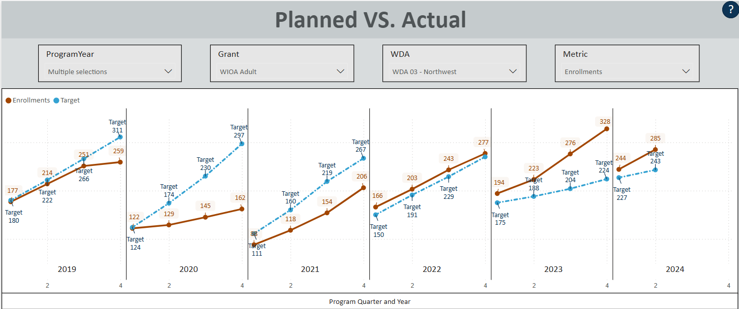
Northwest : Contractual Enrollment Goals and Outcomes
ADULT
Notes:
I will be going through these data slides quickly as we don’t have time for a deep dive. If you would like to take a closer look, these graphs and all the data I’m about to present will be posted on our website. I’m also available to follow up meetings if you have questions about any of these numbers.
Also note that with these enrollment slides, the red solid line indicates actual enrollments and the blue doted lines indicate the targets.
Now: As shown by these graphs, the Northwest Workforce Board had a bit of a slump in their Adult Enrollments, but since Program Year 2022 they have consistently met or gone beyond enrollment targets set.

Slide 9
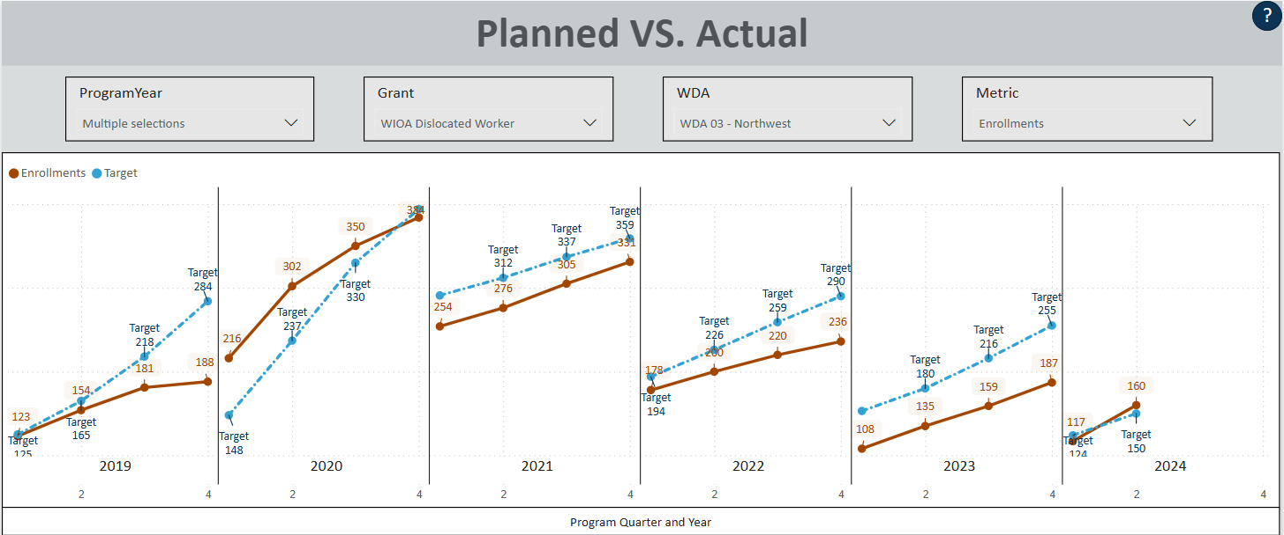
Northwest : Contractual Enrollment Goals and Outcomes
DISLOCATED WORKER
Notes:
The Dislocated Worker program on the other hand has seen enrollment rates drop since their peak in PY 2020, which mirrors statewide trends.
The current program year, PY 24, marks an improvement in that Northwest is now meeting their enrollment goals, again possibly due to a shift in leadership.

Slide 10
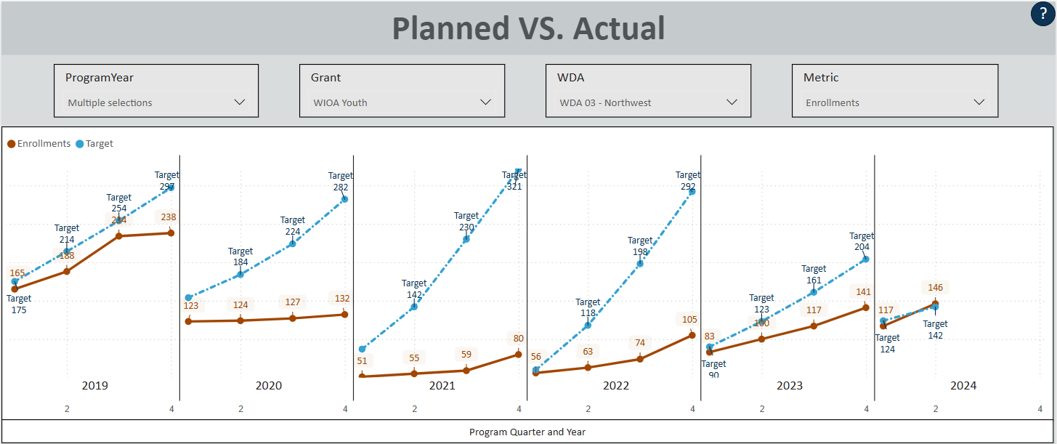
Northwest : Contractual Enrollment Goals and Outcomes
YOUTH
Notes:
Youth enrollment has also improved, reaching its highest levels in the Northwest area since before COVID. This growth is likely driven by an increase in training providers, expanded staff, diverse outreach efforts, and incentive policies that motivate youth to achieve their goals. These positive trends have resulted in full funding utilization and high expenditures on Paid Work Experience services.

Slide 11
Federal Performance Metrics Definitions
Employment Q2
Percentage of participants employed 3-6 months after program exit.
Employment Q4
Percentage of participants employed 9-12 months after program exit.
Median Earnings
Typical wages earned in Q2 after program exit.
Credential Attainment
Percentage earning a recognized degree/certificate within a year after program exit.
Measurable Skills Gains (MSG)
Education/training progress, like completing a semester or earning certification.
Notes:
Before we dive into this next section, I want to do a very quick overview of what the Federal Performance metrics are for all WIOA programs:
Employment Q2 – tells us what percentage of enrollments from that program year were employed around the 6 month point after their exit date from the program
Employment Q4 - tells us what percentage of enrollments from that program year were employed around the 12 month point after their exit date from the program
Median Earning tells us the typical wages earned by that program cohort during their 2nd quarter after exit
Credential attainment measures how many participants in training earned an industry-recognized credential (like a nursing assistant certification or a license drive an 18-wheeler) from that year’s cohort.
Measurable Skills Gains track how many participants in training achieved an incremental milestone, such as a passed semester or proof of class completion.
For additional context on how federal performance works: Each area sets initial goals in collaboration with the Board's research team every 2 years. If local areas meet or exceed 50% of their initial target percentages, they will have passed that metric according to USDOL standards.

Slide 12
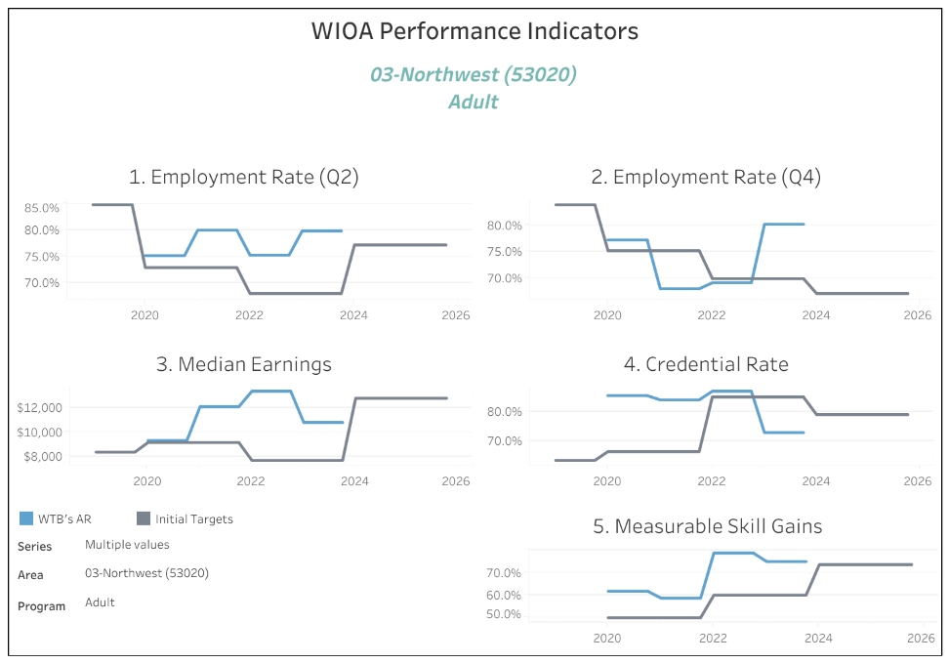
Northwest : Adult Federal Performance Outcomes
Notes:
Northwest is among the state's top-performing areas. The blue lines on these graphs represent actual performance outcomes. Aside from the credential measure, which has been challenging for most areas in the state due to administrative difficulties, every adult program category in the Northwest area has far exceeded last year’s targets. This highlights Northwest's consistently strong performance.

Slide 13
Northwest : Adult Federal Performance Outcomes
Employment Quarter 2
Credential
PY | State Average | Initial Local Target | Actual Outcome
2020 | 59.2% | 72.9% | 75.2%
2021 | 62.2% | 72.9% | 80.0%
2022 | 63.8% | 68.0% | 75.3%
2023 | 69.2% | 68.0% | 79.9%
2024 | 69.0% | 77.2% | 82.1%
PY | State Average | Initial Local Target | Actual Outcome
2020 | 64.6% | 66.4% | 85.5%
2021 | 71.2% | 66.4% | 84.0%
2022 | 73.2% | 85.0% | 87.0%
2023 | 73.3% | 85.0% | 72.9%
2024 | 73.5% | 79% | 73.6%
Q2 Median Earnings
PY | State Average | Initial Local Target | Actual Outcome
2020 | $8,070 | $9,169 | $9,334
2021 | $8,503 | $9,169 | $12,098
2022 | $10,008 | $7,700 | $13,365
2023 | $10,844 | $7,700 | $10,808
2024 | $11,076 | $12,787 | $11,333
Employment Quarter 4
Measurable Skill Gains
PY | State Average | Initial Local Target | Actual Outcome
2020 | 64.2% | 75.2% | 77.2%
2021 | 57.5% | 75.2% | 68.0%
2022 | 63.8% | 69.9% | 69.1%
2023 | 70.1% | 69.9% | 80.1%
2024 | 69.6% | 77.2% | 80.5%
PY | State Average | Initial Local Target | Actual Outcome
2020 | 45.3% | 50.0% | 61.7%
2021 | 54.0% | 50.0% | 58.7%
2022 | 50.9% | 60.0% | 78.6%
2023 | 50.6% | 60.0% | 74.9%
2024 | 46.1% | 73.5% | 68.6%
Notes:
Over the past six program years, Northwest has met all initial targets except for the credential measure, which, despite missing its stretch goal, still received a passing score. Notably, credential targets were highly ambitious in 2022 and 2023.
Every other finalized outcome exceeds initial targets and outperforms the state average by 10–20%.
This trend is also seen in North Central, which we will discuss after Northwest slides.
When a local area significantly surpasses the state average, it raises overall state performance, helping the state meet Department of Labor goals and avoid financial sanctions.

Slide 14
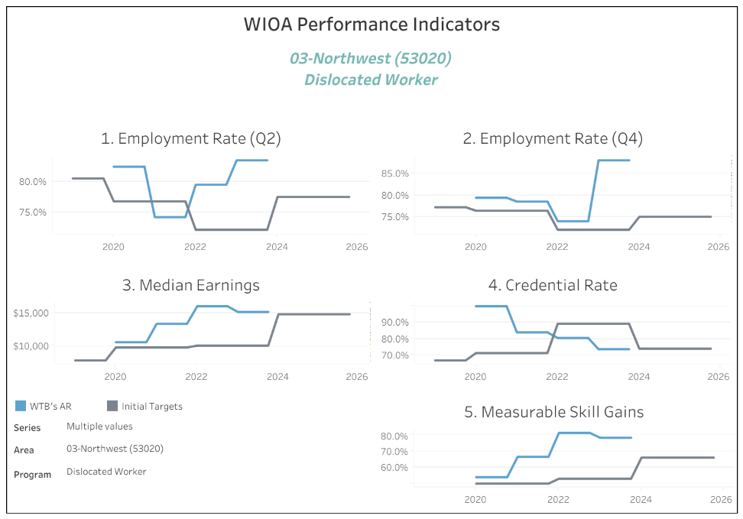
Northwest : Dislocated Worker Federal Performance Outcomes
Notes:
Northwest’s dislocated worker performance remains strong, with all categories—except the credential measure—far exceeding last year’s targets. While they didn’t reach their 90% credential goal, their score remains well above the 50% threshold needed to avoid corrective action.

Slide 15
Northwest : Dislocated Worker Federal Performance Outcomes
Employment Quarter 2
Credential
PY | State Average | Initial Local Target | Actual Outcome
2020 | 62.8% | 76.8% | 82.6%
2021 | 64.8% | 76.8% | 74.1%
2022 | 64.7% | 72.0% | 79.5%
2023 | 71.9% | 72.0% | 83.6%
2024 | 71.9% | 77.5% | 85.7%
PY | State Average | Initial Local Target | Actual Outcome
2020 | 77.8% | 71.3% | 100.%
2021 | 75.5% | 71.3% | 84.0%
2022 | 70.3% | 89.3% | 80.6%
2023 | 72.0% | 89.3% | 73.7%
2024 | 73.9% | 74.0% | 75.7%
Median Earnings
PY | State Average | Initial Local Target | Actual Outcome
2020 | $9,185 | $9,825 | $10,612
2021 | $10,419 | $9,825 | $13,390
2022 | $10,752 | $10,096 | $16,049
2023 | $11,849 | $10,096 | $15,187
2024 | $12,023 | $14,843 | $14,583
Employment Quarter 4
Measurable Skill Gains
PY | State Average | Initial Local Target | Actual Outcome
2020 | 67.6% | 76.4% | 79.4%
2021 | 61.9% | 76.4% | 78.5%
2022 | 64.5% | 72.0% | 74.0%
2023 | 72.2% | 72.0% | 88.0%
2024 | 71.9% | 75.0% | 87.5%
PY | State Average | Initial Local Target | Actual Outcome
2020 | 38.3% | 50.0% | 54.0%
2021 | 56.9% | 50.0% | 66.5%
2022 | 53.8% | 53.0% | 81.2%
2023 | 47.3% | 53.0% | 78.2%
2024 | 45.6% | 66.0% | 71.8%
Notes:
Post-exit employment outcomes for dislocated workers surpass those in the adult program, with quarter 4 rates exceeding employment rates at six months. This trend indicates increasing employment over time, underscoring the program’s lasting impact.
The most recent employment rate for dislocated workers nears 90%, nearly 30% above the state average.
While all performance targets are important for federal accountability, employment rates are the most critical, as the ultimate goal of these programs is to secure sustainable jobs for participants. The numbers speak for themselves—Northwest helps 9 out of 10 dislocated workers retain employment for a full year post-services.
Median earnings in Northwest also exceed both state averages and initial targets.
Despite not fully meeting credential targets, their scores remain well above passing and still surpass the state average.
Additionally, measurable skills gains are exceptionally high, again 20-30% higher than the state average, likely boosting the overall state scores.

Slide 16
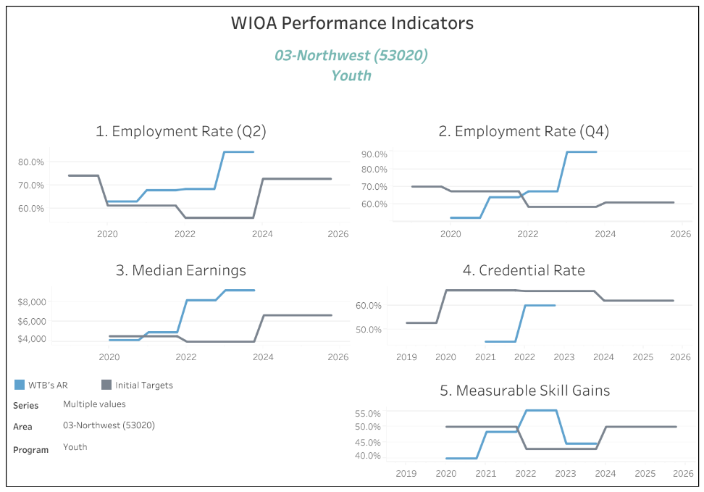
Northwest : Youth Federal Performance Outcomes
Notes:
Northwest's youth program is particularly impressive. Despite Youth being one of the most barriered populations in WIOA programs, most of Northwest’s federal performance outcomes have far exceeded expectations.

Slide 17
Northwest : Youth Federal Performance Outcomes
Employment Quarter 2
Credential
PY | State Average | Initial Local Target | Actual Outcome
2020 | 56.1% | 61.3% | 63.1%
2021 | 57.5% | 61.3% | 67.9%
2022 | 59.1% | 56.0% | 68.4%
2023 | 64.2% | 56.0% | 84.4%
2024 | 64.6% | 72.8% | 69.7%
PY | State Average | Initial Local Target | Actual Outcome
2020 | 63.6% | 66.3% | 55.0%
2021 | 42.5% | 66.3% | 44.9%
2022 | 41.7% | 66.0% | 60.0%
2023 | 44.9% | 66.0% | 76.9%
2024 | 45.0% | 62.0% | 83.3%
Median Earnings
PY | State Average | Initial Local Target | Actual Outcome
2020 | $3,822 | $4,548 | $4,165
2021 | $4,567 | $4,548 | $4,941
2022 | $4,703 | $4,004 | $8,152
2023 | $5,185 | $4,004 | $9,140
2024 | $5,100 | $6,646 | $10,695
Employment Quarter 4
Measurable Skill Gains
PY | State Average | Initial Local Target | Actual Outcome
2020 | 59.0% | 67.3% | 52.3%
2021 | 57.8% | 67.3% | 64.0%
2022 | 59.8% | 58.5% | 67.3%
2023 | 66.3% | 58.5% | 89.7%
2024 | 65.4% | 61% | 81.3%
PY | State Average | Initial Local Target | Actual Outcome
2020 | 39.4% | 50.0% | 40.0%
2021 | 36.2% | 50.0% | 48.4%
2022 | 35.6% | 43.0% | 55.2%
2023 | 38.4% | 43.0% | 44.7%
2024 | 35.7% | 50.0% | 35.1%
Notes:
For employment, Northwest exceeded expectations by 20% at both the six-month and one-year post-exit marks, again boosting the state average.
The most impressive statistic in this presentation is youth median earnings in Northwest—double the state average and higher than most adult wages statewide. Additionally, youth credential attainment in the region is 30–40% above the state average, further lifting overall state performance.
While measurable skills gains may appear low, note that 2024 data currently reflects only one quarter. With three quarters remaining, final results will provide a clearer picture. Despite a slow start this year, the past two program years exceeded both initial targets and the state average, once again driving state performance upward.
Are there any questions or discussion to be had prior to putting Northwest’s local plan and waiver for direct service provisions up for an official vote?

Slide 18
DRAFT MOTION
Staff Recommendation: The Workforce Board Approve the Northwest Workforce Council’s Local Plan modification and to approve the Northwest Workforce Council to continue as the Direct Services Provider to Title 1B Adult, Dislocated Worker and Youth programs through June 30th, 2026.
Motion, 2nd, Vote…
Notes:
(if pause, prompt with): Madam Chairs, are there any questions or discussion to be had? Or would you like to request a motion?

Slide 19
North Central/SkillSource : Local Area Trends and Significant Changes
Funding & Service Costs
WIOA funding has declined since PY20.
Inflation (+26% since 2019) and rising training/staffing costs impact service delivery.
Lingering COVID Impacts
Workforce performance affected through PY23.
High staff turnover (PY 19-PY22) led to pay/benefit adjustments.
Notes:
Like northwest, and the rest of the state, WIOA funding has declined since like and inflation has gone up. Also similar to northwest, covid had a lingering impact on performance and drove high staff turnover through PY22.

Slide 20
North Central/SkillSource : Local Area Trends and Significant Changes
Labor Market Variability
Local conditions vary: some areas see growth, others downturns.
Industry makeup drives differences in demand.
Customer, Staffing and Policy Changes
Bilingual (Spanish/English) case managers needed to serve all customers effectively.
Strong recovery post-COVID, led by advanced manufacturing & IT data centers, reducing some service demand.
Unemployment remains below state average .
Minimal layoffs from PY21–PY23.
Higher-barrier customers more prevalent post-pandemic.
Increased demand for services during and after COVID.
High turnover (PY19–PY22) in program management, case management, and support staff, mirroring statewide trends.
Stable LWDB leadership despite staff churn.
Youth program retains experienced case managers, with some serving 20+ years, contributing valuable institutional knowledge.
Notes:
Labor Market conditions in the North Central Area were pretty unique compared to most of Washington: they had a really strong recovery after covid, led by manufacturing and IT centers, which reduced service demands. The unemployment in the North Central Area was below the state average and layoffs in this area were also minimal between PYs 21-23.
SkillSource has a need for bilingual Spanish-speaking case managers. They also have had higher-barriered customers looking for services through the adult program post-pandemic, which has increased demand for those services.
Like Northwest, the state, and really the entire country, there was really high turnover rates during program years 19-22. Despite this, leadership in this area remained stable, allowing the programs to remain stable. In particular, the youth program was able to retain really experienced case managers who had 20+ years of experience.

Slide 21
North Central/SkillSource : Contractual Spending Goals and Outcomes
North Central Program & Spending Strategy
Strong strategic planning & adaptability in response to market shifts and participant demand.
Regular reallocations & transfers maximize funding utilization.
High Work Experience & Out-of-School Youth expenditure ratios, exceeding federal minimums.
Strong partnerships with education providers for GED reengagement, showcasing effective fund braiding and collaboration
Consistent spending across WIOA programs (PY19–PY25), meeting obligation rates and youth spending metrics.
Youth Program Success:
Notes:
Today and historically, SkillSource has always had a very strong strategy that adapts to market shift in the demand on their customers. They consistently spend across all WIOA program and meet obligation rates and youth spending metrics.
Their youth program has a particularly robust spending strategy that allows them to maximize funding and exceed federal requirements for their spending on Work Experience services. They have strong partnerships with education providers and lead the stae in service integration with these institutions.

Slide 22
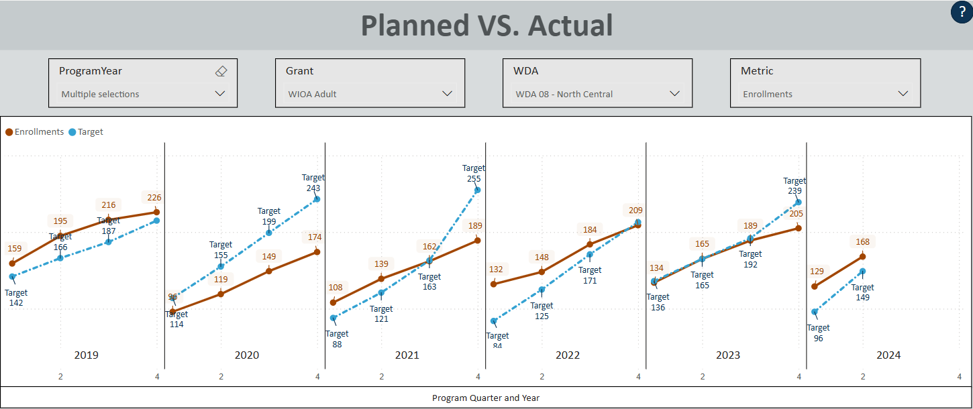
North Central/SkillSource : Contractual Enrollment Goals and Outcomes
Adult
Notes:
SkillSource has remained consistent in their enrollment habits with the Adult program, hovering around 200 enrollments per program year.

Slide 23
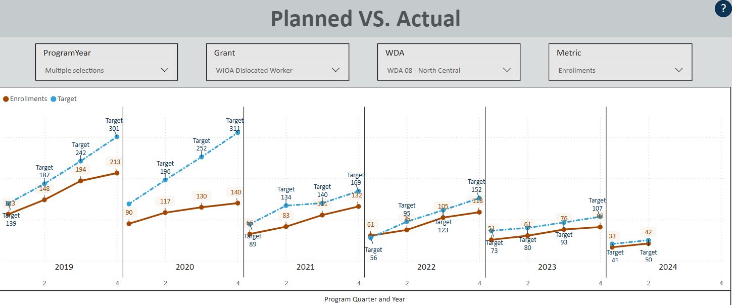
North Central/SkillSource : Contractual Enrollment Goals and Outcomes
DISLOCATED WORKER
Notes:
While Dislocated worker enrollments reflect a strong labor market with minimal layoffs.
This lack of demand for dislocated worker programs have led to DW funding being transferred to the adult program, since that is where the demand is being seen in this area.
These lower enrollment numbers for dislocated workers in the North Central area also reflects SkillSources expanded use of the Incumbent Worker Training program, likely enhancing employer competitiveness and perhaps contributing to layoff prevention.

Slide 24
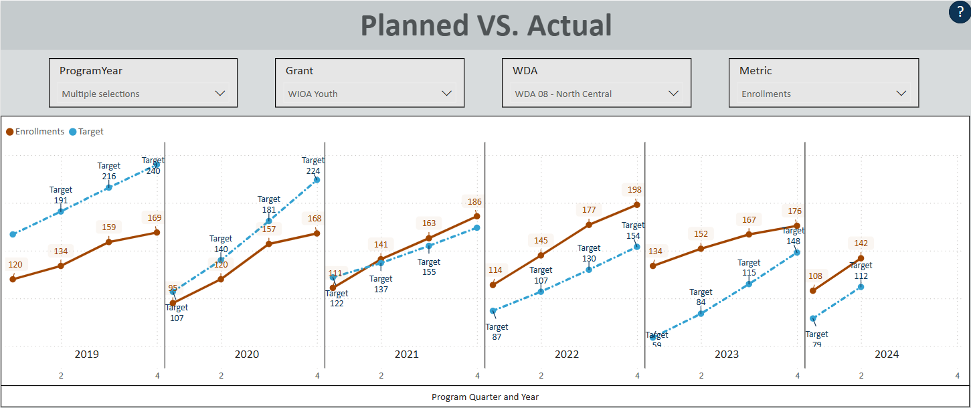
North Central/SkillSource : Contractual Enrollment Goals and Outcomes
YOUTH
Notes:
Notably, SkillSource is one of the few areas in the state that has not seen a notable shift in youth enrollments pre – during – and post COVID.
They consistently carry-in a high number of youths from one program year to the next.
And despite a changing labor market and the unique challenges of a largely rural workforce area, SkillSource consistently meets or exceeds nearly all Youth program contractual targets with GMO.

Slide 25
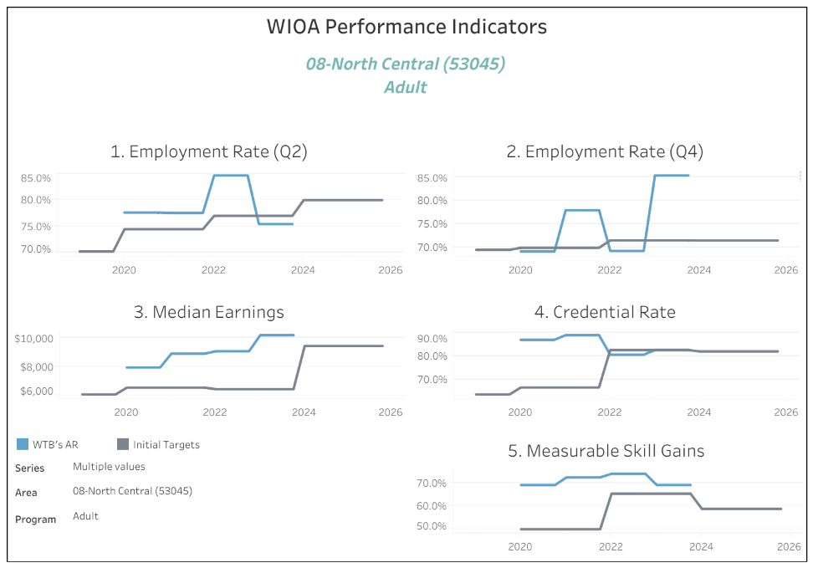
North Central/SkillSource : Adult Federal Performance Outcomes
Notes:
Like Northwest, SkillSource is a leader in federal performance outcomes. Their staff not only boost the state average through strong performance but also elevate other local boards by sharing best practices and data entry strategies—serving as a rising tide that lifts all boats.
Adult Performance with SkillSource consistently has the highest scores in the state, across almost every program and metric, as shown by the blue lines shown on this graph.

Slide 26
North Central/SkillSource : Adult Federal Performance Outcomes
Employment Quarter 2
Credential
PY | State Average | Initial Local Target | Actual Outcome
2020 | 59.2% | 74.5% | 77.6%
2021 | 62.2% | 74.5% | 77.6%
2022 | 63.8% | 77.0% | 84.7%
2023 | 69.2% | 77.0% | 75.4%
2024 | 69.0% | 80.0% | 80.0%
PY | State Average | Initial Local Target | Actual Outcome
2020 | 64.6% | 66.4% | 86.9%
2021 | 71.2% | 66.4% | 88.9%
2022 | 73.2% | 82.5% | 80.5%
2023 | 73.3% | 82.5% | 82.5%
2024 | 72.5% | 81.9% | 77.5%
Median Earnings
PY | State Average | Initial Local Target | Actual Outcome
2020 | $8,212 | $6,549 | $7,944
2021 | $8,212 | $6,549 | $8,900
2022 | $8,070 | $6,442 | $9,065
2023 | $8,070 | $6,442 | $10,179
2024 | $9,500 | $9,429 | $11,193
Employment Quarter 4
Measurable Skill Gains
PY | State Average | Initial Local Target | Actual Outcome
2020 | 64.2% | 69.8% | 69.0%
2021 | 57.5% | 69.8% | 77.9%
2022 | 63.8% | 71.9% | 69.2%
2023 | 70.1% | 71.9% | 85.3%
2024 | 69.6% | 71.9% | 81.5%
PY | State Average | Initial Local Target | Actual Outcome
2020 | 45.3% | 50.0% | 69.1%
2021 | 54.0% | 50.0% | 72.4%
2022 | 50.9% | 65.4% | 73.9%
2023 | 50.6% | 65.4% | 69.1%
2024 | 46.1% | 58.8% | 51.9%
Notes:
A closer look reveals that employment outcomes for the Adult program, both six months and one year post-exit, consistently exceed initial local targets and surpass the state average by 10–20 percentage points.
Adult median earnings have also improved over time, consistently outperforming initial targets and now exceeding state averages.
Like Northwest, SkillSource excels in Adult Credential and Measurable Skills Gains outcomes, regularly surpassing both initial targets and the state average. While Program year 2024 rates are slightly lower than usual for SkillSource, they still remain above the state average.
On that point, it’s important to note that 2024 data, particularly for measurable skills gains rates, is preliminary and reflects only the 1st quarter of this current program year. Areas, like North Central, that finalize data entry corrections closer to June typically see Measurable Skills Gains numbers increase as the program year progresses.

Slide 27
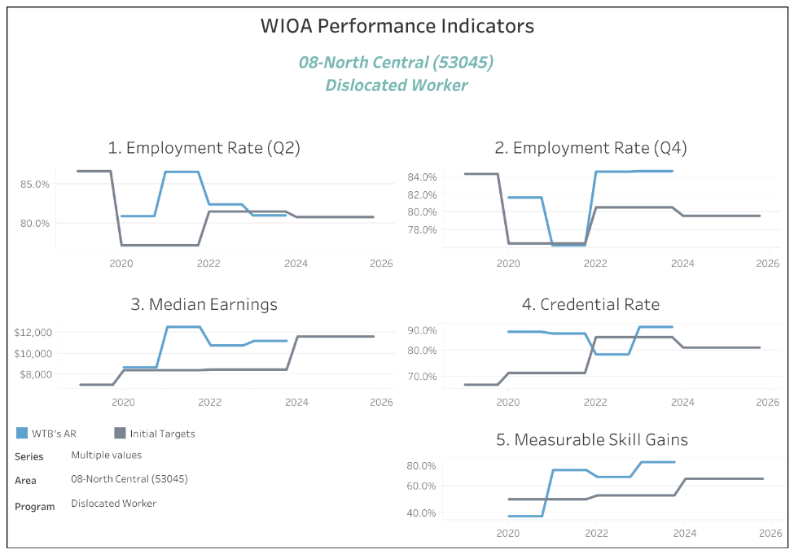
North Central/SkillSource : Dislocated Worker Federal Performance Outcomes
Notes:
Dislocated worker are also looking really good – as indicated by the blue lines, every measure for the dislocated worker program hovers around 80-90% success rates in their actual outcomes.

Slide 28
North Central/SkillSource : Dislocated Worker Federal Performance Outcomes
Employment Quarter 2
Credential
PY | State Average | Initial Local Target | Actual Outcome
2020 | 62.8% | 77.2% | 80.9%
2021 | 64.8% | 77.2% | 86.5%
2022 | 64.7% | 81.5% | 82.4%
2023 | 71.9% | 81.5% | 81.0%
2024 | 71.8% | 80.8% | 80.6%
PY | State Average | Initial Local Target | Actual Outcome
2020 | 77.8% | 71.3% | 87%
2021 | 75.5% | 71.3% | 86.4%
2022 | 70.3% | 85.0% | 78.4%
2023 | 72% | 85.0% | 88.9%
2024 | 73.2% | 81% | 91.2%
Median Earnings
PY | State Average | Initial Local Target | Actual Outcome
2020 | $9,185 | $8,401 | $8,670
2021 | $10,419 | $8,401 | $12,526
2022 | $10,752 | $8,458 | $10,763
2023 | $11,849 | $8,458 | $11,193
2024 | $12,023 | $11,610 | $11,861
Employment Quarter 4
Measurable Skill Gains
PY | State Average | Initial Local Target | Actual Outcome
2020 | 67.6% | 76.5% | 81.7%
2021 | 61.9% | 76.5% | 76.3%
2022 | 64.5% | 80.6% | 84.6%
2023 | 72.2% | 80.6% | 84.6%
2024 | 71.9% | 79.6% | 84.7%
PY | State Average | Initial Local Target | Actual Outcome
2020 | 38.3% | 50.% | 37.6%
2021 | 56.9% | 50.% | 71.3%
2022 | 53.8% | 52.8% | 66.3%
2023 | 47.3% | 52.8% | 77.1%
2024 | 46% | 65% | 61.4%
Notes:
Employment rates for dislocated workers who receive services from SkillSource are consistently 10–20% higher than the state average at both the six-month and one-year post-exit marks, once again helping to lift the overall state average.
SkillSource also consistently meets its initial median earnings targets and often exceeds the state average, despite serving a predominantly rural area.
Measurable Skills Gains and credential rates are even more impressive, typically ranking about 20% above the state average and further contributing to statewide performance gains.

Slide 29
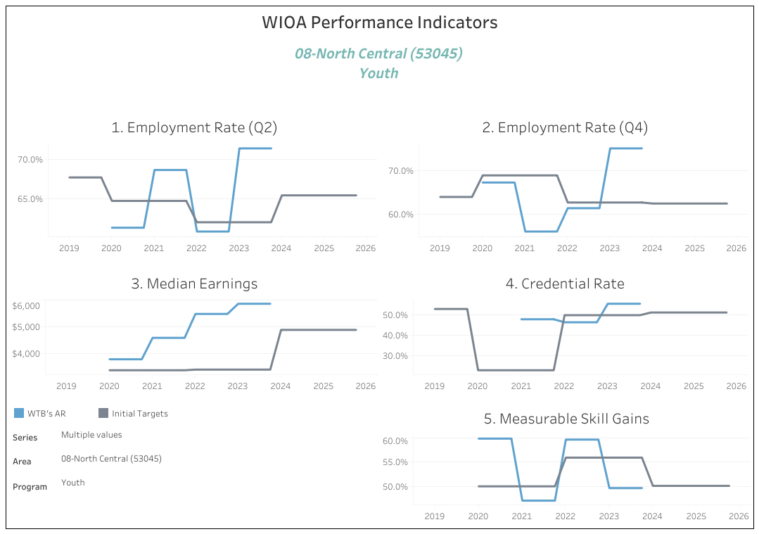
North Central/SkillSource : Youth Federal Performance Outcomes
Notes:
As shown in this graph, while SkillSource's Youth program lags slightly in Measurable Skills Gains in most recent program years, all youth metrics in this area consistently meet or exceed initial targets and maintain overall scores well above the 50% pass rate.

Slide 30
North Central/SkillSource : Youth Federal Performance Outcomes
Employment Quarter 2
Credential
PY | State Average | Initial Local Target | Actual Outcome
2020 | 56.1% | 64.7% | 61.3%
2021 | 57.5% | 64.7% | 68.7%
2022 | 59.1% | 62% | 60.8%
2023 | 64.2% | 62% | 71.4%
2024 | 64.6% | 65.4% | 66.7%
PY | State Average | Initial Local Target | Actual Outcome
2020 | 63.6% | 23.1% | 0%
2021 | 42.5% | 23.1% | 47.7%
2022 | 41.7% | 49.7% | 46.3%
2023 | 44.9% | 49.7% | 55.2%
2024 | 43.6% | 51% | 60.8%
Median Earnings
PY | State Average | Initial Local Target | Actual Outcome
2020 | $3,822 | $3,370 | $3,780
2021 | $4,567 | $3,370 | $4,579
2022 | $4,703 | $3,395 | $5,471
2023 | $5,185 | $3,395 | $5,851
2024 | $5,267 | $4,876 | $5,416
Employment Quarter 4
Measurable Skill Gains
PY | State Average | Initial Local Target | Actual Outcome
2020 | 59% | 68.8% | 67.2%
2021 | 57.8% | 68.8% | 56%
2022 | 59.8% | 62.6% | 61.3%
2023 | 66.3% | 62.6% | 75%
2024 | 66.5% | 62.4% | 77.9%
PY | State Average | Initial Local Target | Actual Outcome
2020 | 39.4% | 50% | 59.8%
2021 | 36.2% | 50% | 47.1%
2022 | 35.6% | 55.9% | 59.6%
2023 | 38.4% | 55.9% | 49.6%
2024 | 36% | 50.1% | 48.3%
Notes:
A closer look at the numbers shows that youth served by SkillSource achieve strong employment outcomes, with rates at both six months and one year post-exit consistently meeting or exceeding targets—often surpassing the state average.
Youth median earnings also remain well above the passing threshold, reflecting SkillSource’s commitment to strong program outcomes. As seen across all SkillSource Title 1B programs, Measurable Skills Gains (MSGs) and credential attainment stand among the highest in the state, consistently exceeding initial targets due to best practices and diligent data entry.
Are there any questions or discussion to be had prior to putting North Central’s waiver for direct service provisions up for an official vote?

Slide 31
DRAFT MOTION
Staff Recommendation: The Workforce Board Approve the North Central Workforce Board (SkillSource) to continue as the Direct Services Provider to Title 1B Adult, Dislocated Worker and Youth programs through June 30th, 2026.
Motion, 2nd, Vote…
Notes:
(if pause, prompt with): Madam Chairs, are there any questions or discussion to be had? Or would you like to request a motion?

