Slide 1
State Workforce Data Integration
Kim Goutam, PhD – Manager, Data Integration Initiatives
Irene Vidyanti, PhD – State Chief Data Officer (WaTech Partner – Enterprise Data Platform)
Wendy Wickstrom – CS Web & User Experience Manager (WaTech Partner – Resident Portal)
March 2025
Notes:
Note: working group deliberating and discussing design and implementation strategy

Slide 2
“NO WRONG DOOR” DATA INTEGRATION PROJECT

Slide 3
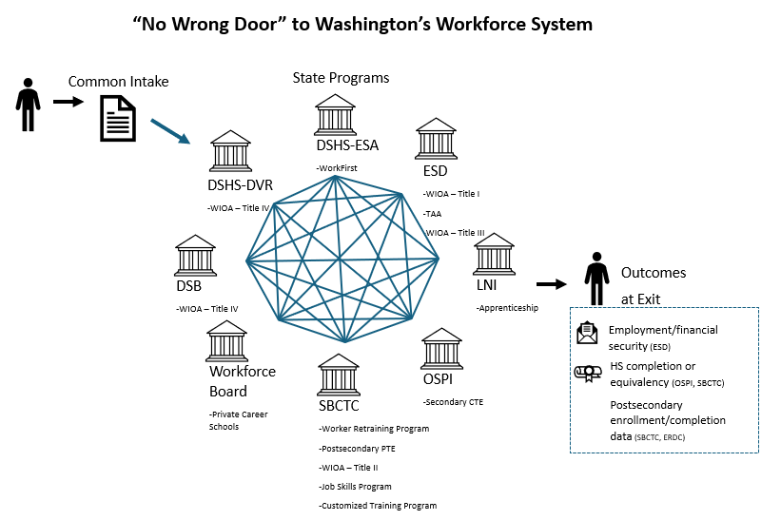
The Solution
Notes:
Harness a "no wrong door" approach and integrated information to improve the customer experience and outcomes of jobseekers and support employers in accessing a trained and needed workforce.
Data-owning agencies

Slide 4
The Value
Intake
Jobseekers
Reduce confusion navigating system
Reduce redundancies and address “intake fatigue”
Ensure access—especially for individuals with significant barriers.
Frontline Staff
Automate eligibility determinations
Systematize referrals
Effectively bundle and coordinate services
Save administrative time
Program Administrators
Address reporting limitations and challenges
Provide data insights for continuous cycles of improvement
Referrals
Service Delivery
Impact

Slide 5
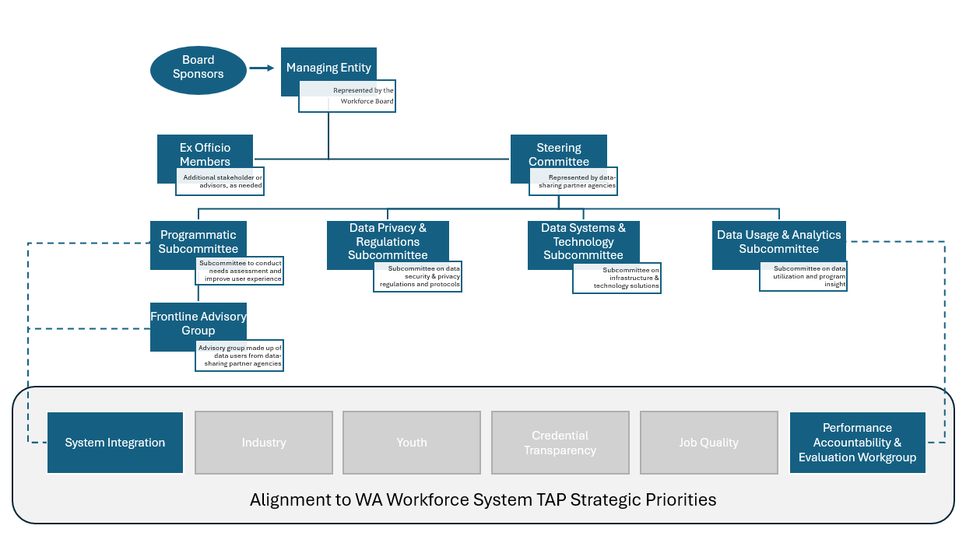
Project Governance & Strategic Alignment

Slide 6
Progress and Upcoming Priorities
Governance
Data Governance Council
Letters of Intent/MOU
DSA templates
Regulatory landscape analysis
OCM analysis
Enterprise Data Platform
Data warehousing
Repository of workflows/pipelines
Data security
Analytics environment
Data Matching Solution
SaaS Solution
Low-lift
Cost-effective
High accuracy
Bridge with WaTech's IAM
Resident Portal Pilot
Coordinated intake and referral
Secure repository of shareable eligibility documentation
Informed consent
Notes:
OCM and legal consultation--UPenn
Full automation of data pipeline, including receiving, cleaning, and storing
Validation Study – approaching 90% accuracy, new applications ($125)
Piloting of Resident Portal, coordinated intake screener tool

Slide 7
Change Management
Anthro-Tech prepared an OCM Report for the Data Integration Project and determined the following insights:
The Project involves an extensive quantity of interconnected stakeholder groups, requiring significant effort, time, and resources.
This volume of work is high, including mandated quality assurance, organizational change management, regulatory consultation, data scientist, and administrative support. However, this funding was not acquired, leaving the singular Project Lead in a position to continue managing all efforts.
The Project demonstrates robust and high-functioning project formation in formalizing partnerships and project documentation.
Notes:
OCM – strategy and approach to engage partners and stakeholders to increase project success

Slide 8
Resourcing
Budget Source | 2023 | 2024 | 2025 | 2026
 | 1 FTE | 1 FTE | 1 FTE + Dev. | 1 PTE
General Fund-State | $216,000 | $216,000 | $216,000 | $124,000
WaTech's IM Program |  |  | $142,700
Total | $216,000 | $216,000 | $358,700 | $124,000
Challenges
Yielded high impacts despite consistently lean operations
Resourcing cliff for upcoming biennium
Significantly scaling back to address resource constraints, but prioritizing project momentum and progress
Notes:
Focusing on Universal ID

Slide 9
Budgeting Adjustments
Un-resourced
Savings
Delayed Implementation
AAG and legal consultation
Pass-through costs to partner agencies
PT for personnel
Internal IT Staff Support
WaTech Enterprise Data Platform and Resident Portal Partnerships
SaaS Data Matching Solution
Data lookup portal
Local system connections and implementation
Help desk support
Expanded program evaluation
Mandated QA and OCM supports

Slide 10
WaTech's Strategic Alignment
Resident Portal
Simplified, coordinate pre-intake tool
Enterprise Data Platform
Improved Data Sharing

Slide 11
ENTERPRISE DATA PLATFORM

Slide 12
Enterprise Data Platform: Powering a Connected Washington
The Enterprise Data Platform is a statewide initiative to support cross-agency data integration, insights, and transparency.
Public safety agencies
ENTERPRISE DATA PLATFORM
Integrated Services Portal
Inter-agency data hub
Natural resources agencies
INTEGRATION
Collect data from different agencies
Cross-agency operational or analytics reports
Social service & workforce agencies
ANALYTICS
Transform data into meaningful easy-to-understand metrics
Cross-agency public dashboards
Transportation agencies
DISTRIBUTION
Deliver data to internal or public-facing products serving different needs
For the workforce system:
Integrated workforce data hub
Statewide program evaluation
Statewide workforce dashboards
Integrated job / training portals
Health agencies
Workforce integration is our first cohort—paving the way for future initiatives.
Notes:
How this works:
Behind Jane’s seamless experience is the Enterprise Data Platform, working behind the scenes to integrate, analyze, and distribute data. The Enterprise Data Platform connects, processes, and delivers insights from across state agencies—providing real-time visibility into services, so Jane gets a cohesive, transparent view of her government interactions—just like tracking an online order. Better yet, she can also look at overall government metrics to also understand how her government is working.
We can communicate how the government is doing at a macro level, providing accountability and showing what works well and what needs improvement. We can also show a personalized view showing statuses of their applications.
Washingtonians deserve clear insights into the services they rely on. These clear streamlined insights will give them the confidence to navigate state services confidently, building trust in government and encouraging continuous improvements in public service.
Building on previous work:
This will build on prior work we have done on the Enterprise Data Platform in partnership with Results Washington, as well as the work we’ve done in building the foundational capabilities of the platform.
Outcome:
By weaving data together, we’re ensuring that no Washingtonian is left in the dark about the services they rely on.

Slide 13
Enterprise Data Platform: Supporting Integrated Workforce Services
Enterprise Data Platform provides the data infrastructure for better operational coordination across workforce agencies.
Benefits for both programs
Faster, more cost-effective deployment for the No Wrong Door Initiative so jobseekers get streamlined experience faster.
The workforce system is leading the way as the first Enterprise Data Platform cohort, helping shape how we support multi-agency data initiatives.
Streamlining jobseekers’ experience
Data integration eliminates redundant paperwork and improves follow-through across agencies.
Jobseekers will navigate an integrated, instead of fragmented, workforce system.
DSHS-ESA
DSHS-DVR
Serves integrated data back to agencies and to integrated portals (e.g. Resident Portal)
DSB
Workforce Board
ENTERPRISE DATA PLATFORM
Enables shared screening and better real-time service coordination
SBCTC
Enables integrated reporting across the workforce system
LNI
Enables real-time workforce system dashboards
OSPI
ESD
Notes:
How this works:
Behind Jane’s seamless experience is the Enterprise Data Platform, working behind the scenes to integrate, analyze, and distribute data. The Enterprise Data Platform connects, processes, and delivers insights from across state agencies—providing real-time visibility into services, so Jane gets a cohesive, transparent view of her government interactions—just like tracking an online order. Better yet, she can also look at overall government metrics to also understand how her government is working.
We can communicate how the government is doing at a macro level, providing accountability and showing what works well and what needs improvement. We can also show a personalized view showing statuses of their applications.
Washingtonians deserve clear insights into the services they rely on. These clear streamlined insights will give them the confidence to navigate state services confidently, building trust in government and encouraging continuous improvements in public service.
Building on previous work:
This will build on prior work we have done on the Enterprise Data Platform in partnership with Results Washington, as well as the work we’ve done in building the foundational capabilities of the platform.
Outcome:
By weaving data together, we’re ensuring that no Washingtonian is left in the dark about the services they rely on.

Slide 14
What’s Next? Sustaining & Scaling Workforce Integration
Enterprise Data Platform has funding for the next biennium, albeit at reduced levels
The workforce system remains a key partner in demonstrating the power of integrated data for Washington residents.
Washington state is well-positioned to scale and enhance integrated services.
The Enterprise Data Platform Operating Model: Flexible Support Levels
Operating Support Model | Who is it for? | What Agencies Provide | What WaTech Provides
Self-Service | Agencies with data capacity & IT resources | Manage their own data engineering, analytics, and integration | Secure platform, governed access, compliance support
Hybrid Support | Agencies needing some technical support but with internal data staff | Provide some technical staff (data analysts, IT) | Guidance on integration, governance, and analytics setup
Full Support | Small agencies or multi-agency projects without dedicated data staff | Subject matter expertise on service needs | Full technical support (data engineering, analytics, dashboard development)
Why This Matters for Workforce Data Integration:
Ensures agencies get the right level of support based on their capacity.
Enables scalability as needs evolve.
Keeps the No Wrong Door initiative sustainable by adapting to changing requirements.
Notes:
How this works:
Behind Jane’s seamless experience is the Enterprise Data Platform, working behind the scenes to integrate, analyze, and distribute data. The Enterprise Data Platform connects, processes, and delivers insights from across state agencies—providing real-time visibility into services, so Jane gets a cohesive, transparent view of her government interactions—just like tracking an online order. Better yet, she can also look at overall government metrics to also understand how her government is working.
We can communicate how the government is doing at a macro level, providing accountability and showing what works well and what needs improvement. We can also show a personalized view showing statuses of their applications.
Washingtonians deserve clear insights into the services they rely on. These clear streamlined insights will give them the confidence to navigate state services confidently, building trust in government and encouraging continuous improvements in public service.
Building on previous work:
This will build on prior work we have done on the Enterprise Data Platform in partnership with Results Washington, as well as the work we’ve done in building the foundational capabilities of the platform.
Outcome:
By weaving data together, we’re ensuring that no Washingtonian is left in the dark about the services they rely on.

Slide 15
RESIDENT PORTAL

Slide 16
Transform and personalize the way Washington residents engage with state government.

Slide 17
At Its Core
Accessible
Equitable & Inclusive
Responsible
Human-centered
Trustworthy
Responsive
Available
Integrated

Slide 18
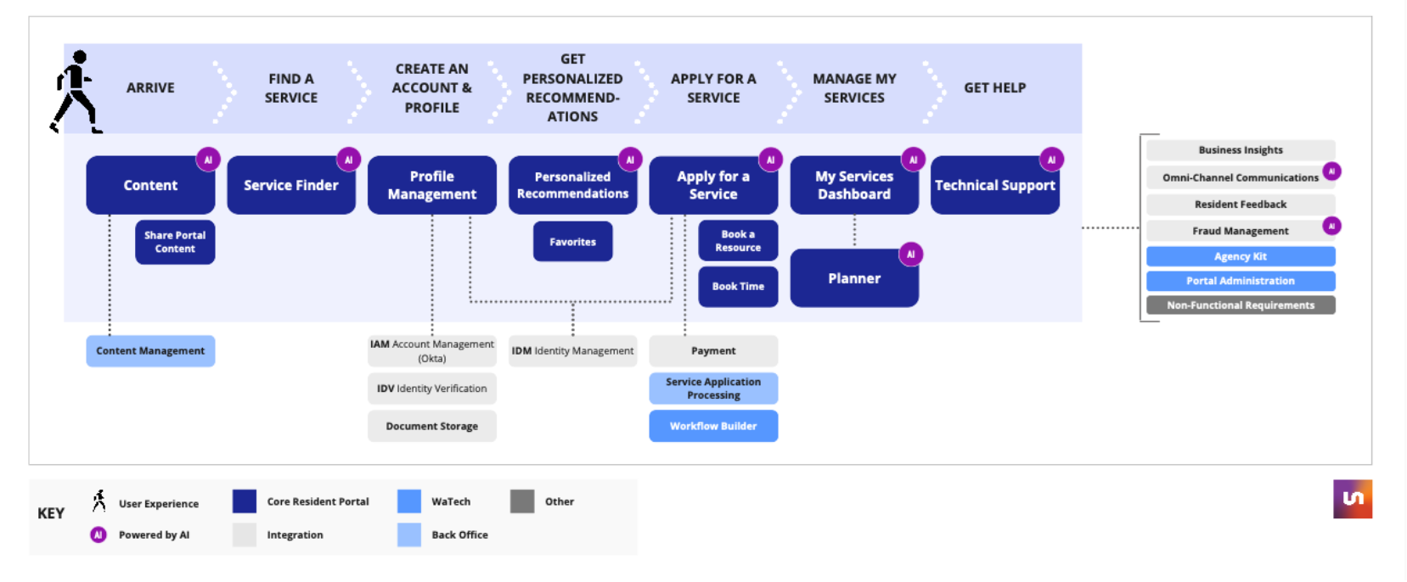
Resident Portal Capabilities Overview

Slide 19
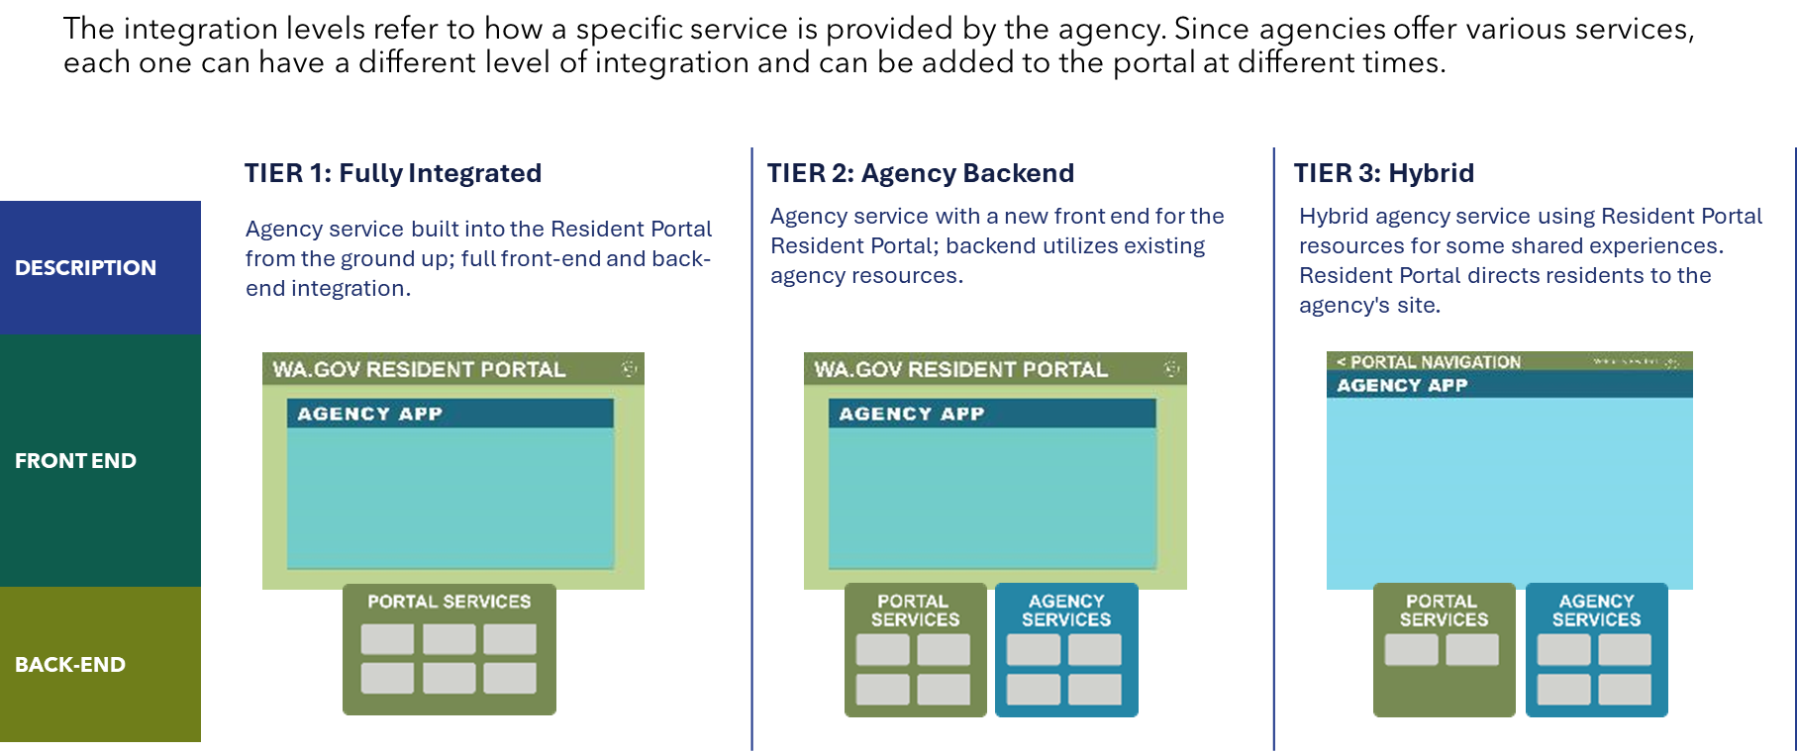
Agency Service Integration Tiers

Slide 20
Implementation Strategy

Slide 21
No Wrong Door/Resident Portal Pilot
Value Proposition
Resident Portal will offer most, if not all, of the capabilities needed for the No Wrong Door shared screener process
Cost savings
Reduced duplicative effort
Benefits for Both Programs
Resident Portal is early in pilot phase and is excited to have engagement from agency coalitions
No Wrong Door initiative can expedite release of shared intake and promote services quicker
Excellent User Experience
Together we will offer residents an easy way to find the workforce services they are eligible for and connect them directly to those services. Improving their lives, with ease.

Slide 22
Future Resourcing

Slide 23
Business Case

