Slide 1
March Legislative Update
Nova Gattman
Deputy Executive Director
Legislative Liaison

Slide 2
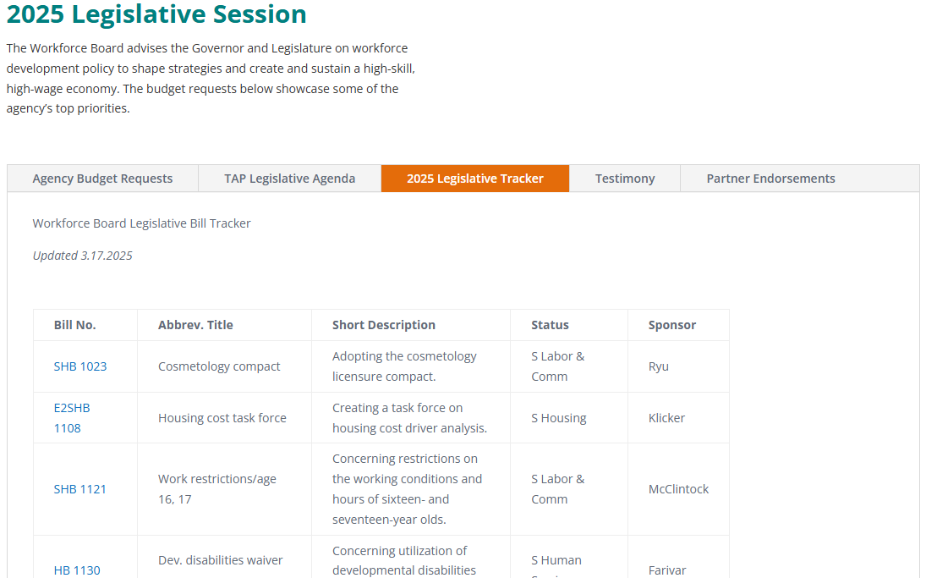
Board Staff Legislative Portfolio
Staff were tracking 398 bills this
session at the peak.
Down to 125 that are actively moving through the process.
Workforce Board legislative site includes:
List of bills and status.
Budget requests and links to decision package write-ups.
Follow along at https://wtb.wa.gov/about-us/workforce-board-legislative-tracker/.

Slide 3
Workforce Board State Budget Update
All agencies were required to submit proposed funding cuts equaling at least 6% of their budget in January.
Majority of Workforce Board proposed cuts were from state funding for school licensing and veteran program approval activities.
The Tuition Recovery Trust Fund would support these work streams through Fiscal Year 2027 (cut in state funding, proviso approval).
Maintained budget items from Governor Inslee’s December 2024 proposal, including:
Career Bridge Modernization – finish line work and permanent staffing.
Long-Term Care Workforce Initiative.
Legislative Budget proposals will be released next week.

Slide 4
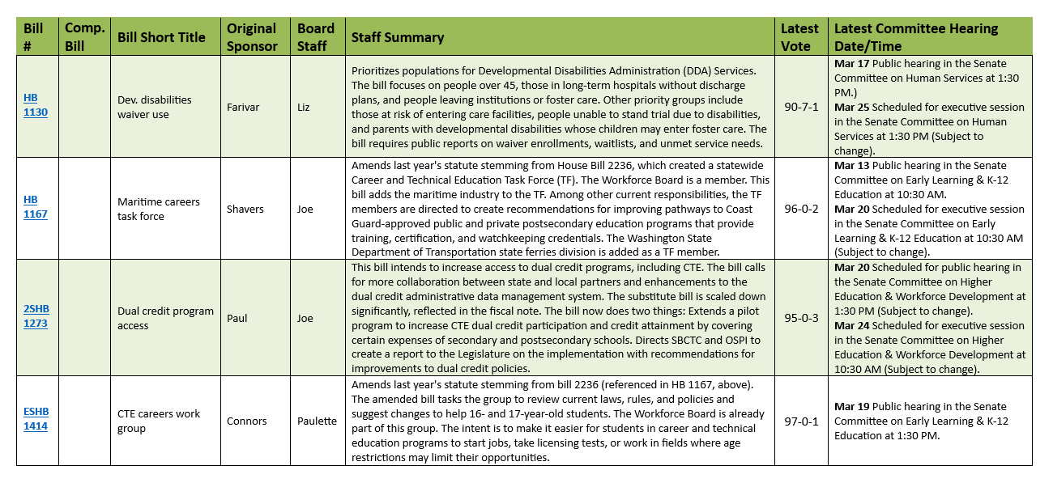
See Our Bill Handout for More Info!
Board staff have prepared an updated handout to be shared in chat for this meeting with bill status information.
Intended to be a leave-behind for follow-up after the meeting.
Information on many of the bills shared today is highlighted in that document.
Reminder: Bills included in today’s documents and presentation do not indicate a position on any legislation.

Slide 5
A Selection of Workforce Bills of Interest
For more bill summaries, see our legislative tracker handout, provided electronically.
To review our Legislative activities online:
https://wtb.wa.gov/about-us/workforce-board-legislative-tracker/

Slide 6
1167 – Maritime Careers TF
Prime Sponsor: Rep. Shavers
Status: Senate Early Learning & K-12 Education – Exec Session 3/20.
Updates the CTE Task Force – passed into law in 2024.
Wade Larson represents the Workforce Board on this group.
Adds a new responsibility to include an analysis of maritime industry pathways.
Includes recommendation development of opportunities for programs that lead to or articulate to those approved by the Coast Guard.

Slide 7
1273 – Dual Credit Program Access
Prime Sponsor: Rep. Paul
Status: Senate Higher Education & Workforce – Exec Session scheduled 3/24.
Continues a grant-funded pilot program (SBCTC lead, with OSPI) to increase CTE dual credit and credential attainment in prof/tech programs.
Grant funds can support: Catalogue of dual credit programs, aligning CTE dual credit with postsecondary pathways, and TA/PD for developing and awarding dual credit.
SBCTC, w/ OSPI, will report to the Legislature with a final report in August 2027 with recommendations for improving state dual credit policies, career counseling on dual credit, and increasing access.

Slide 8
1414 – CTE Careers Work Group
Prime Sponsor: Rep. Connors
Status: House Education – Exec Session Scheduled 2/18.
Updates the CTE TF (referenced in HB 1167) to include examining barriers to training, certification, and employment for 16-17 y/o students who have completed CTE programs.
The group should make recommendations on barrier removal for categories of work for minors who have a license from another agency, hour restrictions, and other training and employment barriers.
Report due from OSPI to the Legislature November 15, 2026.
The TF is extended through June 30, 2027 (currently 2026).

Slide 9
5542 – HS Completers/CTC Tuition
Prime Sponsor: Sen. Boehnke/Rep. Entenman
Status: Awaiting a hearing in House Appropriations.
SBCTC request legislation that would allow for a tuition waiver for all individuals participating in a high school equivalency (GED) certificate program.
Specifically, the bill removes the limit that waivers may only be offered for individuals 19 years of age and older.

Slide 10
QUESTIONS?
nova.gattman@wtb.wa.gov
wtb.wa.gov
(360) 709-4600

