Slide 1
Basic education for adults
System Spotlight for the Workforce Board
Will Durden, State Board for Community and Technical Colleges
Kenny Austin, Adult Education Advisory Council
March 20th, 2025

Slide 2
Basic education for adults - motivation
To be sure, the people who are the focus of current college initiatives are going to school to improve their economic prospects. But people also go back to school to feel their minds working and learn new things, to help their kids, to feel competent, to remedy a poor education, to redefine who they are, to start over. – Mike Rose, Back To School

Slide 3
The challenge
Washington state job growth from 2023 to 2032 projected at 12.8%
Projected shortfall of nearly 600,000 credentialed workers over the decade
An “oversupply” of uncredentialed workers (high school credential or less)
Estimated 498,000 Washington adults hold less than a high school diploma or equivalent
Sources: Washington Roundtable, US Census Data

Slide 4
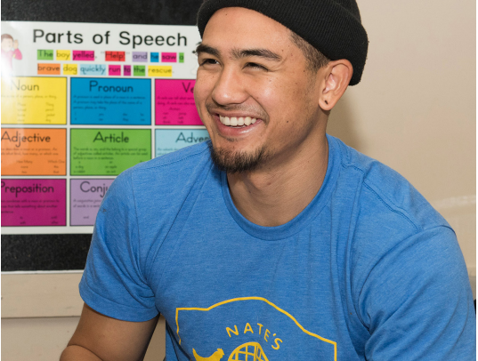
One solution: basic education for adults (beda)
BEdA programs offer academic instruction and education services below the postsecondary level that increase an individual’s ability to:
  Read, write, speak English, and perform math for the attainment of a secondary school diploma or equivalent
  Transition to postsecondary education and training; and
  Obtain employment
Photo courtesy of Seattle Central College

Slide 5
Beda funding and administration
Seed funding provided by federal government (~$14m)
Corrections BEdA programs funded by state Department of Corrections
Administered by the State Board for Community and Technical Colleges
Part of Washington state’s Workforce Development System
Notes:
In state TAP plan

Slide 6
State & Local investments
~$3.2m supports new arrivals primarily from Afghanistan and Ukraine
$750,000 supports Washington state’s nationally recognized Integrated Basic Education and Skills Training program
Colleges heavily subsidize BEdA programs with local funds

Slide 7
beda students
36,459 individuals served
29% White
28% Hispanic or Latino
17% More than One Race
15% Asian
10% Black or African American
<1% American Indian, Alaskan Native, Native Hawaiian, or Other Pacific Islander
19% 19-24
58% 25-44
14% 45-54
63% female
37% male
Nearly 1 in 3 adults who come to BEdA to learn English hold a postsecondary or professional degree from another country

Slide 8
Beda program models
High School+ (HS+)
Students who complete High School+ receive a Washington state high school diploma from their community or technical college.
Students can demonstrate competency through prior transcripts and other life experience.
Integrated Basic Education and Skills Training (I-BEST)
Places upper-level BEdA students directly into college certificate and degree programs.
Nationally recognized with a Tier 1 rating by the What Works Clearinghouse

Slide 9
BEdA performance (2022-23)
Performance Indicator | Target | Actual | Target Met
Employment (2nd Quarter) | 30.1% | 35.39% | Yes
Employment (4th Quarter) | 30.1% | 38.73% | Yes
Median Earnings | $4,975 | $6,075 | Yes
Credential Attainment Rate | 44% | 56.71% | Yes
Measurable Skill Gains | 40% | 41.59% | Yes

Slide 10
Credential attainment – federally funded
Credential | 2016-17 | 2017-18 | 2018-19 | 2019-20 | 2020-21 | 2021-22 | 2022-23
Diploma | 4,404 | 4,584 | 4,435 | 4,183 | 4,117 | 3,505 | 3,365
GED | 1,107 | 1,067 | 774 | 438 | 274 | 264 | 292

Slide 11
Corrections education credential attainment
Award Type | F22 | F23 | F24
High School Equivalency (GED) | 181 | 219 | 249
High School Diploma (HS+) | 158 | 351 | 458

Slide 12

Adult education advisory council
The Adult Education Advisory Council was created by statute in 1991 (RCW 28B.50.254)
“The advisory council shall advise the state board for community and technical colleges and the workforce training and education coordinating board concerning adult basic education and literacy programs.”
“The advisory council’s actions shall be consistent with the state comprehensive plan for workforce training and education prepared by the workforce board.”

Slide 13
Council membership
Kenny Austin, General Public Position (Chair)
Brice Montgomery, Department of Social and Health Services
Cindy Guertin-Anderson, Department of Commerce
Ricardo Chavez, Adult Education Teacher
Amy Diehr, Private Literacy Organization
Jennifer Barber, Council for Basic Skills
Anne Goranson, Employment Security Department
Kelli Graham, Community Based Organization
Adrienne Jones, Labor Representative
Eleni Papadakis, Workforce Board
Mandy Paradise, Office of Superintendent of Public Instruction
Aaron Parrott, SkillSource Workforce Development Council
Lucretia Robertson, Library Program
Lionel Candido-Flores, Council for Basic Skills
Lin Zhou, Higher Education Agency
Chris Bailey, State Board for Community and Technical Colleges
Notes:
Vacant positions: Department of Corrections, Student, Private Sector

Slide 14

AEAC – focus on beda subpopulations
Four committees focused on:
  Students seeking high school credential
  Justice-impacted students in corrections education programs
  College-educated English learners
  Non-college educated English learners

Slide 15
the aeac wants to hear from you!
How can the Adult Education Advisory Council best advise the Workforce Board on matters related to adult basic education?
Which aspects of the state plan are most salient for the work of the AEAC?

Slide 16
Questions and feedback
Contact information
Will Durden | Director, Basic Education for Adults, SBCTC wdurden@sbctc.edu
Kenny Austin| Chair, Adult Education Advisory Council
kennyryanaustin@gmail.com

